Slide 1
Employee Data Analysis using Excel
STUDENT NAME: DEEPASRI.B
REGISTER NO: 312211088[asunm1423312211088]
DEPARTMENT: B.com(Accounting & Finance)
COLLEGE: Dr. M.G.R. Janaki College of Arts & Science for Women

Slide 2
PROJECT TITLE:
Employee Performance Analysis using Excel

Slide 3
AGENDA:
Problem Statement
Project Overview
End Users
Our Solution and Proposition
Dataset Description
Modelling Approach
Results and Discussion
Conclusion

Slide 4
PROBLEM STATEMENT:
To write a problem statement on employee performance, you need to identify the specific area of performance that is problematic, such as low productivity, high absenteeism, or poor quality of work. Then, you should describe the impact of this problem on the organization, such as decreased revenue or dissatisfied customers.

Slide 5
PROJECT OVERVIEW:
A performance review is a formal assessment in which a manager evaluates an employee’s work performance. Also called a performance appraisal or an employee evaluation, it can be structured in different ways to effectively identify strengths and weaknesses, offer constructive feedback, and set goals for the future.

Slide 6
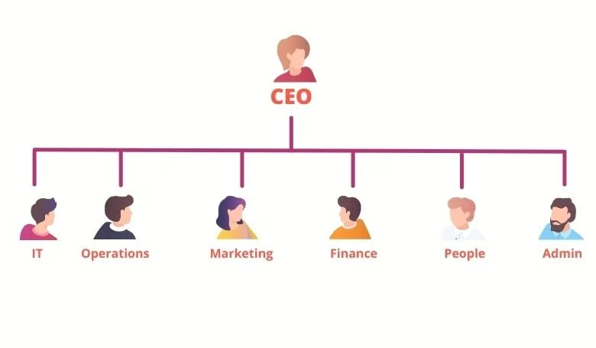

WHO ARE THE END USERS?
An end user is a person or other entity that consumes or makes use of the goods or services produced by businesses. In this way, an end user may differ from a customer since the entity or person that buys a product or service may not be the one who actually uses it. End users are the people or entities that use a product or service. They are often the customers who buy the product, but they aren't always the same thing.

Slide 7
OUR SOLUTION AND ITS VALUE PROPOSITION:
CONDITIONAL FORMATTING:
Conditional formatting in Excel can be used to highlight patterns and trends in data, and to make it easier to identify specific cells. Conditional formatting makes it easy to highlight certain values or make particular cells easy to identify. This changes the appearance of a cell range based on a condition (or criteria).
FILTER:
Filters in Excel can be used to temporarily hide data in a table or range of cells. The FILTER function allows you to filter a range of data based on criteria you define.

Slide 8
FORMULA:
Formulas in Excel are used to perform calculations and solve problems. Formulas calculate values in a specific order. A formula always begins with an equal sign (=). Excel for the web interprets the characters that follow the equal sign as a formula.
GRAPH:
In simple terms, a graph is a visual element that represents data in a worksheet. You will be able to analyze the data more efficiently by looking at a graph in Excel rather than numbers in a dataset. Graphs are a common method to visually illustrate relationships in the data.
PIVOT TABLE:
A PivotTable is an interactive way to quickly summarize large amounts of data. You can use a PivotTable to analyze numerical data in detail, and answer unanticipated questions about your data. A Pivot Table is used to summarise, sort, reorganise, group, count, total or average data stored in a table. It allows us to transform columns into rows and rows into columns.

Slide 9
Dataset Description:
Employee Performance Data – Downloaded at KAGGLE.
Totally 26 features are there but we are considering at 7 features.That features are mentioned below,
Employee id- Numerical Values.
First Name- Text Format.
Business Unit- Text Format(BPC/ CCDR/ EW/ MSC/ NEL/ PL/ ect..).
Employee Type- Text Format(Contract/ Full-Time/ Part-Time).
Gender Code- Text Format(Male/ Female).
Employee Rating- Numerical Values(1 to 5).
Performance Level- Formula Based( VERY HIGH/ HIGH/ MEDIUM/ LOW).

Slide 10
THE "WOW" IN OUR SOLUTION:
Formula:
=IFS(Z2>=5,”VERYHIGH”,Z2>=4,”HIGH”,Z2>=3,”MED”,TRUE,”LOW”)
Creating a charts :

Slide 11
MODELLING:
Data Collection:
Step 1: To download data on kaggle, you need to define what you want to learn from your research. ...
Step 2: Choosing Data Collection Method. ...
Step 3: Planning Data Collection Procedures. ...
Step 4: Collecting Data. ...
Feature Collection:
Step 1:In Employee performance data sheet have a 26 features.
Step 2: I used only 7 features to prepare a chart.
Step 3: They are ( Emp Id, Name, Business Unit, Emp Type, Gender, Emp Code, Performance Level).
Data Cleaning:
Step 1:To identify the missing values.
Step 2:Then filter out the missing values.
Step 3: Cleaning and Organizing the Data.

Slide 12
Performance Level:
Step 1: Identify performance or behavioral issues that need improvement.
Step 2:Explain the level of performance and behavior expected.
Step 3:lSchedule progress meetings with the employee.
Pivot Table:
Step 1:Enter your data into a range of rows and columns.
Step 2: Sort your data by a specific attribute (if needed).
Step 3:Highlight your cells to create your pivot table.
Step 4:Drag and drop a field into the “Row Labels” area
Step 5:Drag and drop a field into the “Values” area.Fine-tune your calculations.
.

Slide 13
RESULTS:

Slide 14
CONCLUSION:
This having a powerful tools that helps to me understand . This project created an excel dashboard that does just that , it: Tracks your progress , Highlights your strengths and weakneses , Helps your supervisor make informed decisions about your growth. This project can help me like; Improve skills , Get better job opportunities, Achieve career goals.

